Slide 1
MRI Intensity Inhomogeneity Correction
Lianli Liu
20/12/2013

Slide 2
Outline
Motivation – source of intensity inhomogeneities
Prospective Methods for intensity correction
Retrospective Methods for intensity correction
Intensity correction in synthetic CT project

Slide 3
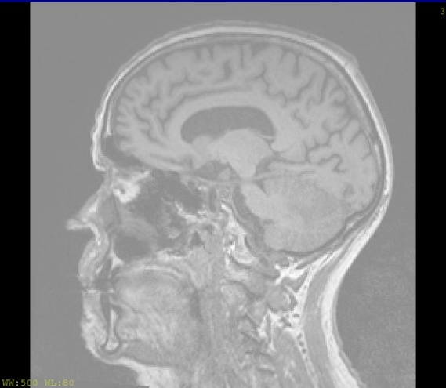
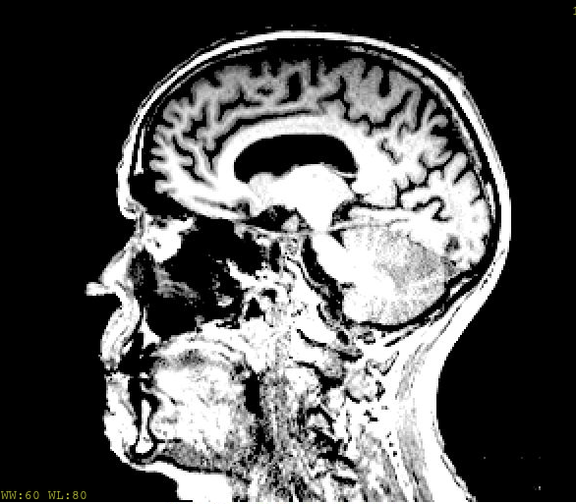
Motivation
MRI images have non-uniform intensities due to the inhomogeneous radio frequency field across the subject
These nonuniformities lead to variations in image intensity that are not due to the actual variation in signal from the subject
Image analysis tasks are sensitive to such inhomogeneity
examples: segmentation, registration, etc.
Wide window
Narrow window
Notes:
Imperfection in rf pulses; inhomogenous transmission/reception field; penetration effects depend on a subject

Slide 4
Prospective Methods for Intensity heterogeneity correction
B1 mapping and correction
Phantom-based empirical measurement

Slide 5
B1 mapping and correction
Taking the ratio of two different images, with flip angles chosen such that
Spin echo image
Gradient echo image
Field of volume/surface coil
Insko EK, Bolinger L. Mapping of the radiofrequency fied. Journal of Magnetic Resonance A. 1993;103:82–5.

Slide 6
B1 mapping and correction
Workflow
Measured transmission field
Reception sensitivity field (cannot be measured at high field strengths)
Correction matrix:
Wang, Jinghua, et al. "Measurement and correction of transmitter and receiver induced nonuniformities in vivo." Magnetic resonance in medicine 53.2 (2005): 408-417.
Notes:
Biot-Savart law wave behavior finite element needed

Slide 7
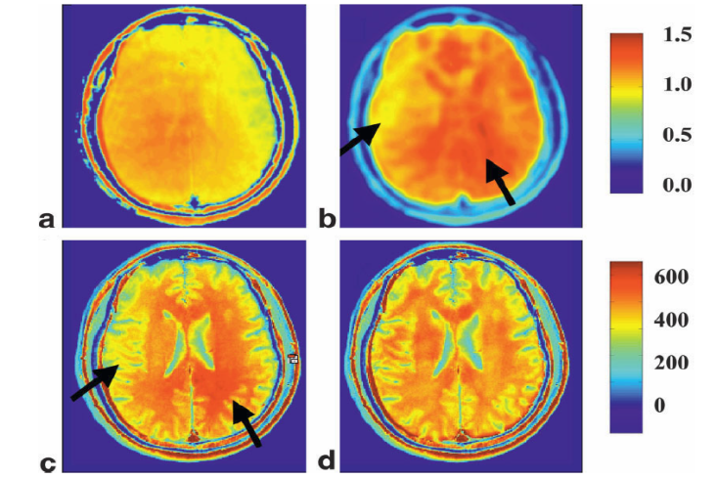
B1 mapping and correction
How to calculate
(a) transmission field (b) reception field
(c) original image (d) corrected image
Wang, Jinghua, et al. "Measurement and correction of transmitter and receiver induced nonuniformities in vivo." Magnetic resonance in medicine 53.2 (2005): 408-417.
Notes:
Choose TE TR to minimize tissue contrust

Slide 8
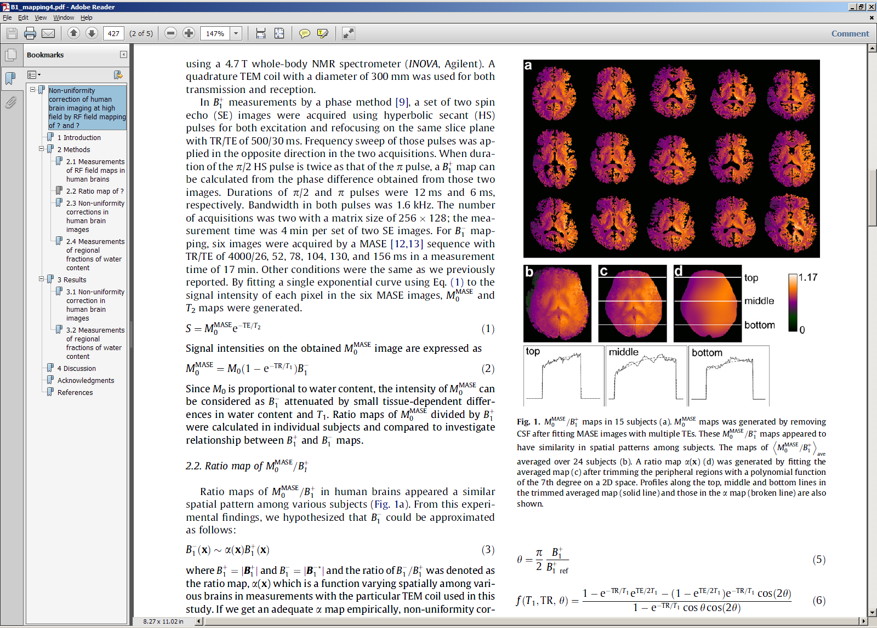
B1 mapping and correction
How to calculate
Ratio map obtained by multi-echo adiabatic spin echo (MASE) and transmission field
ratio map of 15 subjects
Watanabe, etl . "Non-uniformity correction of human brain imaging at high field by RF field mapping of and." Journal of Magnetic Resonance 212.2 (2011): 426-430.

Slide 9
B1 mapping and correction
Comments
B1 mapping is time consuming
How to calculate reception fields accurately remains a problem

Slide 10
Phantom-based measurements
Estimate intensity inhomogeneity field by acquiring an image of a uniform phantom
Limitations
B1 field in vivo differs significantly from that in phantoms
Cannot account for patient induced inhomogeneity
RF coil perturbation is not considered

Slide 11
Retrospective Methods
Filtering based methods
Segmentation based methods

Slide 12
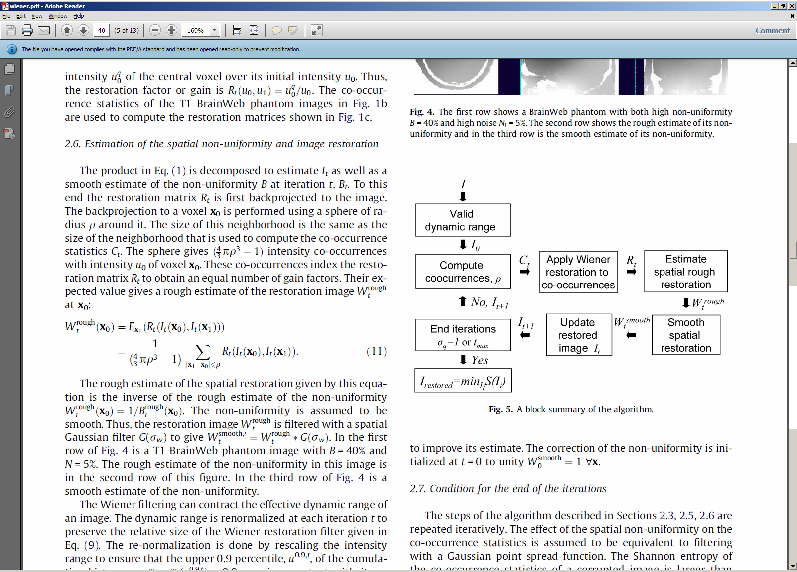
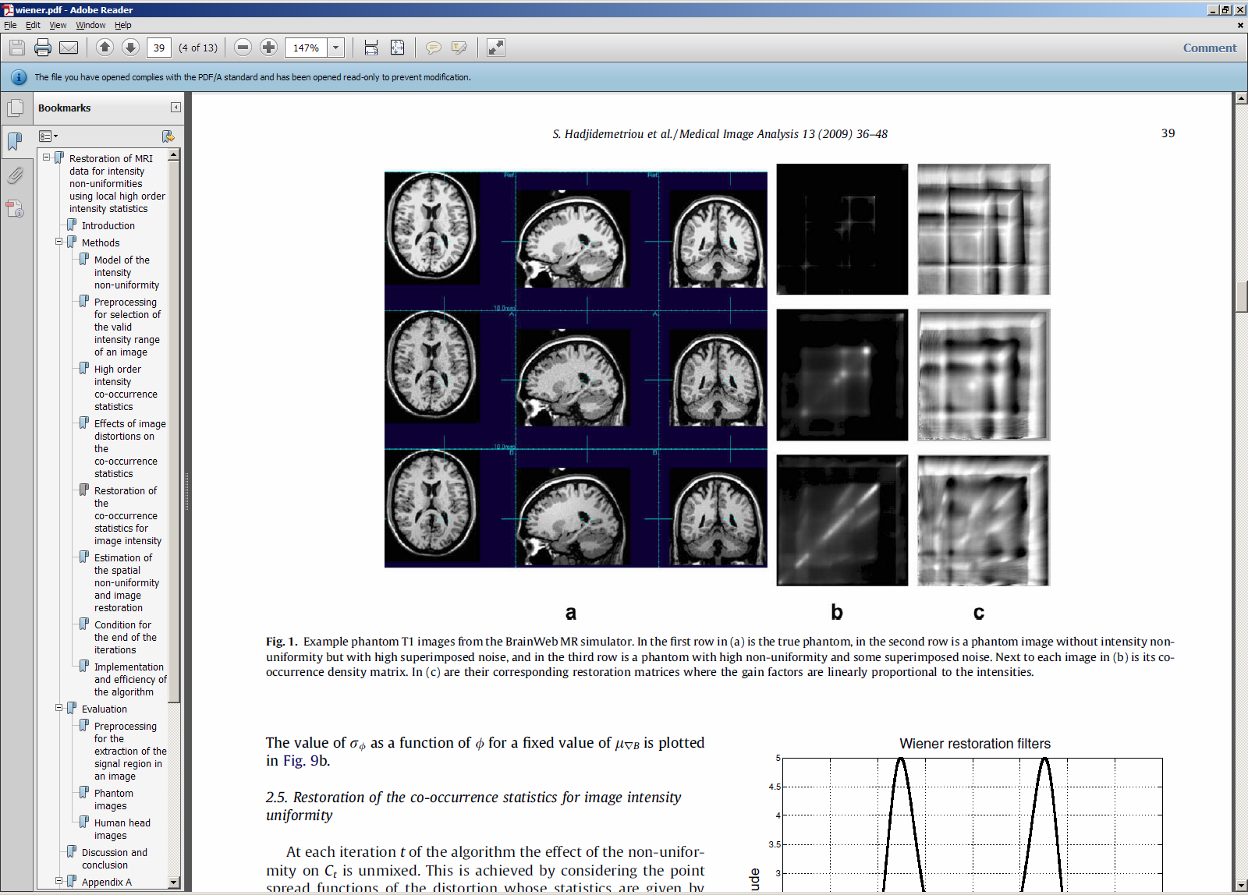
Filtering based method
Inhomogeneous field is modeled as a multiplicative noise
Deconvolution problem → Weiner filter
Effect on higher order statistics of co-occurrence intensity can be modeled as convolution with Gaussian point spread function
Restore intensity co-occurrence map using Weiner filter
Construct image using restored intensity co-occurrence map
co-occurrence map without distortion
co-occurrence map with non uniformity and noise
Hadjidemetriou, Stathis, et al. "Restoration of MRI data for intensity non-uniformities using local high order intensity statistics." Medical image analysis 13.1 (2009): 36-48.
Notes:
H* (f) S(f)/(H2(f)S(f)+N(f))

Slide 13
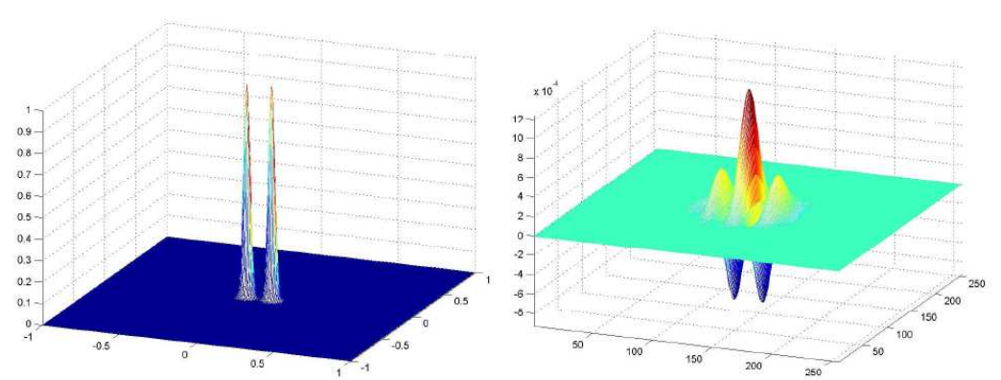
Filtering based method
Model inhomogeneous field as a low frequency signal
Avoid filtering out slow varying signals in real image
Gabor Filtering
Threshold images to avoid noise being enhanced
Smooth the thresholded image using Gabor filter
Restore image using a diffusion process
Gabor filter is chosen for orientation
and modified for a low pass behavior
Ardizzone E, Pirrone R, Mastrella M, et al. A Gabor-based technique for bias removal in MR Images[C]//Engineering in Medicine and Biology Society, 2007. EMBS 2007. 29th Annual International Conference of the IEEE. IEEE, 2007: 1314-1317.
Notes:
Spatial displacement of coils

Slide 14
Filtering based method
Model inhomogeneous field as a low frequency signal
Low pass filtering with scattered noise
Use statistical means to determine the background noise level and edges of image features
Populate noise pixels to ensure uniform distribution
Gaussian filtering
Cohen M S, DuBois R M, Zeineh M M. Rapid and effective correction of RF inhomogeneity for high field magnetic resonance imaging[J]. Human Brain Mapping, 2000, 10(4): 204-211.

Slide 15
Bias field estimation integrated into tissue segmentation on MRI
Modified fuzzy c-means for joint bias field correction and segmentation
Different model: additive ^{[1]} Vs. multiplicative ^{[2]} bias field
Modified objective function for fuzzy c-means
Further constraint
Smooth constraint: mean spread filtering to further smooth the bias field ^{[1]}
Neighbor constraint ^{[2]}
[1] M.Y. Siyal, Lin Yu, An intelligent modified fuzzy c-means based algorithm for bias estimation and segmentation of brain MRI, Pattern Recognition Letters, Volume 26, Issue 13, 1 Oct 2005, 2052-2062
[2] S.R. Kannan, S. Ramathilagam, R. Pandiyarajan , Modified bias field fuzzy c-means for effective segmentation of brain mri, Transaction on Computational Science, Volume 6260, 2011, 127-145

Slide 16
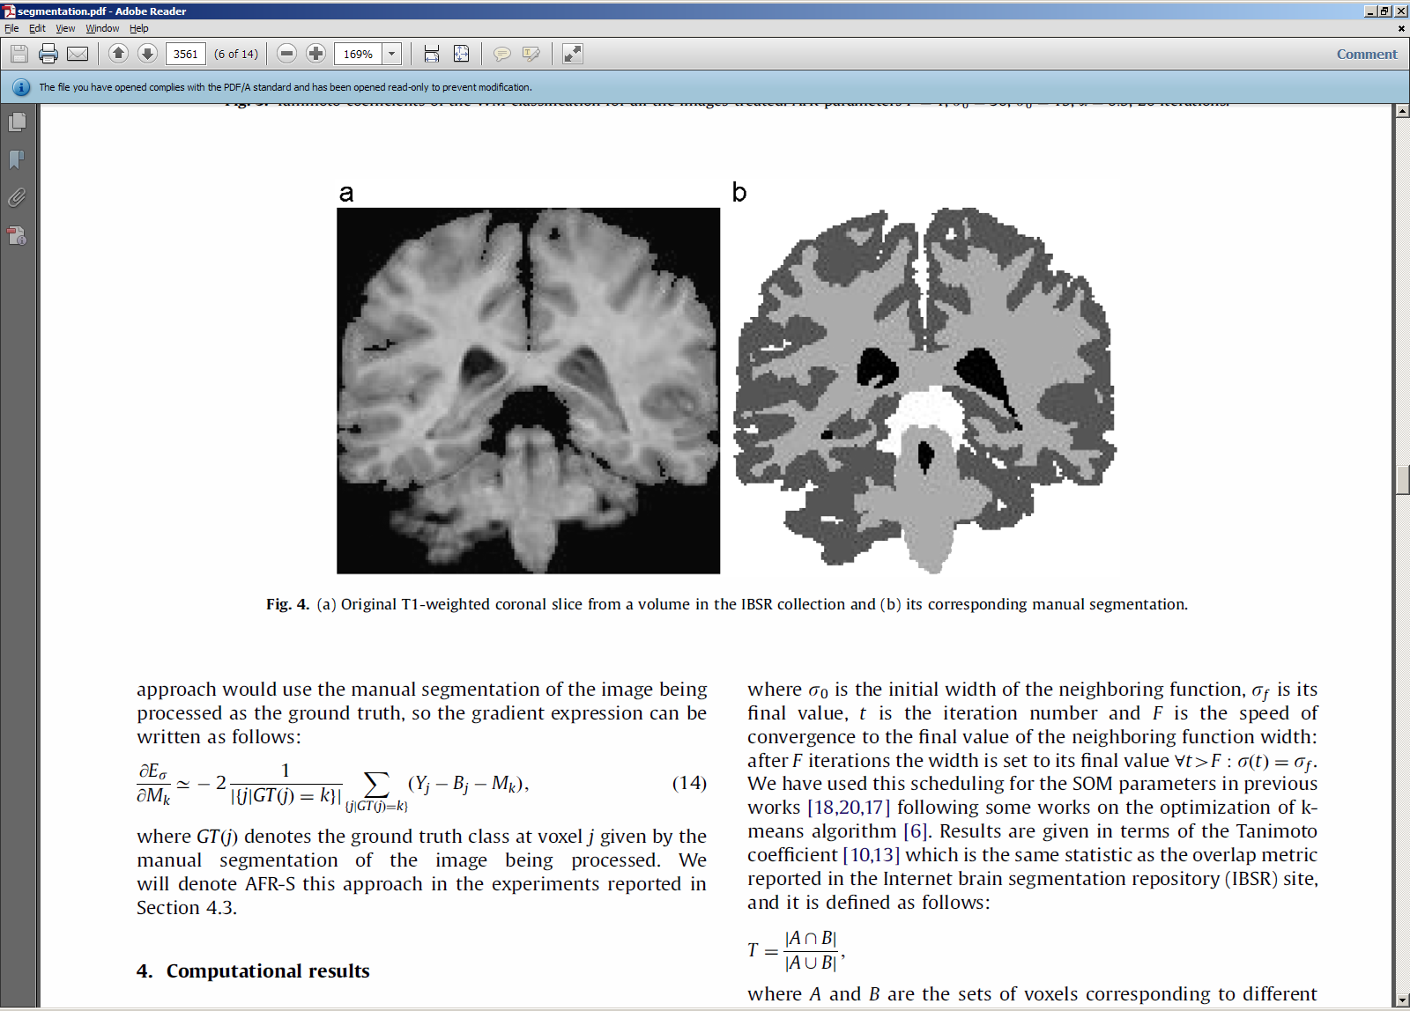
Bias field estimation integrated into tissue segmentation on MRI
Optimize the estimation of biased field
and segmentation jointly
Minimize energy function
Smooth over energy function to introduce neighborhood control
García-Sebastián, etl. "An adaptive field rule for non-parametric MRI intensity inhomogeneity estimation algorithm." Neurocomputing 72.16 (2009): 3556-3569.

Slide 17
Bias field estimation integrated into tissue segmentation on MRI
Estimate biased field based on segmentation result
Generate bias free image using segmentation result and models for different tissue types
Noise populating and Gaussian filtering
Biased field as quotient of original image and bias free image
Gispert, Juan D., et al. "Method for bias field correction of brain T1‐weighted magnetic resonance images minimizing segmentation error." Human brain mapping 22.2 (2004): 133-144.

Slide 18
Challenges with retrospective methods
Decoupling noise and real signals
Multiplicative noise model in Wiener filter
Slow varying signal in patients for low pass filtering
Interaction between accurate segmentation and accurate bias field estimation

Slide 19
Discussion
What is the most realistic initial path for incorporating intensity correction into the synthetic CT project?
B1 mapping may require additional time and special sequence
Fuzzy c-means based methods may be an interesting method for jointly classification and correction.
Computational load
Applicability in populated based method (centroid is not updated)
Filtering based methods, if computationally efficient, should be easy to be incorporated as a pre processing step before segmentation

Slide 20
Thanks!

